Slide 1
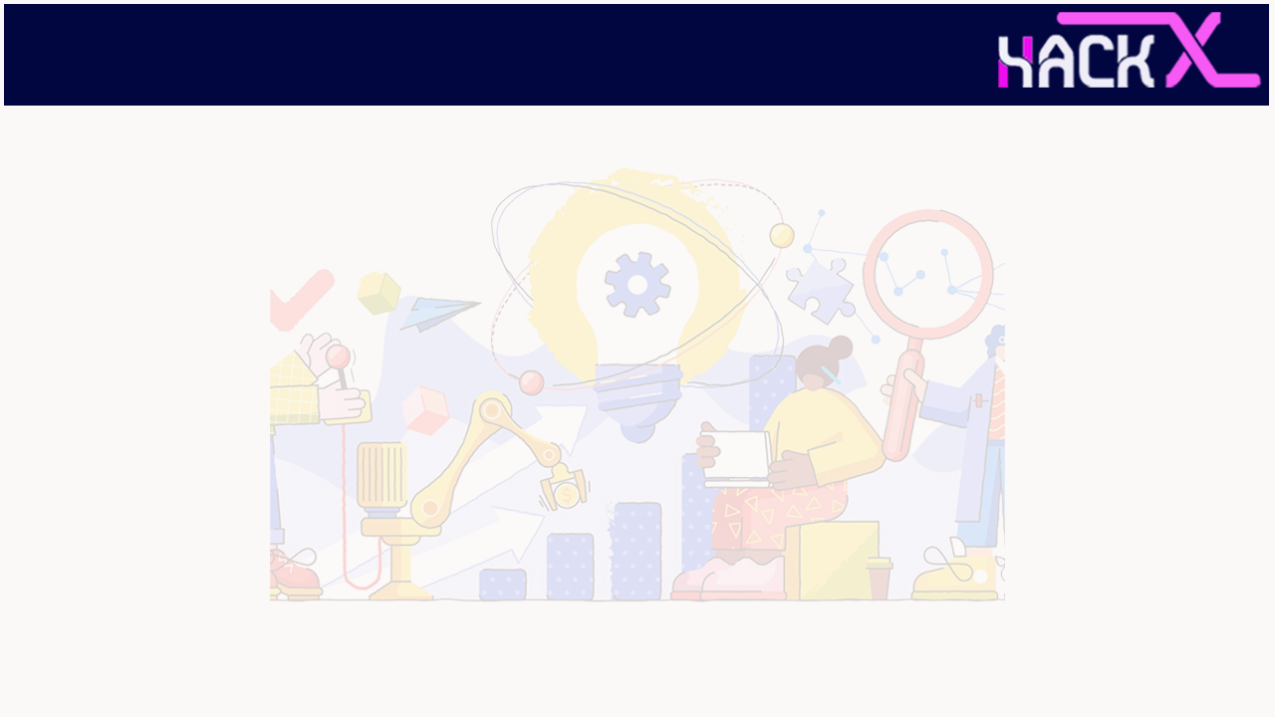
Introduction
Idea Title: ANITA
Idea Theme: Education
Team Members: Soham Malviya (Team Leader)
Problem Statement: Open Innovation:-
Current tools used for online education are extremely inefficient and unmanageable to leverage.
Still instructors must do a lot of work manually, no automated systems are used in institutions.
No proper feedback and recommendation system is present. Students take examinations again and again, but both students and instructors fails, when post examination improvement should happen. As post examination students fails to learn where they must focus more to improve results and not even the instructor knows which topics should be emphasised more.
Still most of the institutions refrain themselves from leveraging online education solutions mainly due to high prices of Ed products available in market or less or no expertise in installation, managing and maintain such system.

Slide 2
ABSTRACT
ANITA is a scalable, reliable, robust Learning Enhancement & Task Automation System, it not only manages the study resources, but also provide advance, efficient and intelligent tools which minimizes work by automation, enhances collaborative learning, improves students to student, instructor to student and vice-versa communication, provides a platform for conducting automated proctored, secure online examination, removes and tackle the inefficiencies of current systems, provides feedback, recommendation, analysis, reports, etc eventually improving the education platform by leveraging innovative solution.
The solution not only focuses on student success, but also focuses on instructor and institution success, by providing tools and features for them, conclusively user’s success is guaranteed with the advent of ANITA in his/her education system.
It is a problem-based solution so it can help people in real-world. The core idea of ANITA is evaluated several times with numerous of parameters. ANITA is innovative, feasible, sustainable and is a practical idea, which will solve problems effectively for institutions, educators, students and will provide high standard solutions with nominal and affordable costing.

Slide 3
NOVELTY
Right now, the systems which are used for education purposes are just incomplete, improper and inefficient hacks which are not appropriate. Currently, not a single product in the market is available which provides a gamut of WORK AUTOMATION, FEEDBACK, RECOMMENDATION, etc with efficiency, seamless connectivity, system scalability within affordable pricing range.
Connecting students and instructors on an interconnected, efficient, easy to use platform, where they can interact and perform almost everything, which can be done in classroom, with the leverage of modern technology.
Automating instructor’s daily tasks so instructor can only focus on teaching.
Feedback is crucial for improvement of students and instructor both. For that we will be providing AI/ML powered system which will assess student’s work and performance in the course and will provide recommendation and analysis to them and a generic analysis to the instructor, so they can improve their work and performance.
Providing easy to use, intuitive, scalable, reliable and connected system to remove the inefficiencies of current system with UI/UX design which can be used and comprehended by everyone.
Providing cloud native application which can be accessed anytime and from anywhere, requires no installation and maintenance, within affordable costing. Eventually enabling institutions, organizations, individual educators, etc. to use modernized solution under their budgets and technological expertise.

Slide 4
TECHNOLOGY STACK
ANITA will be a scalable, reliable, secure cloud native application. It will be SASS(Software-as-a-service). After analysing current need we have researched and then finalized some technologies and services which will help us build solution-
Client Side Technologies-
HTML 5, CSS, JavaScript
SASS
React.js
Server Side Technologies-
Node.js
Express.js
MySQL DB
RESTful API
Architecture, Cloud and Deployment Services-
Microservices Architecture
IBM Cloud
Docker/ Kubernetes

Slide 5
IMPLEMENTATION
Use of modern technology with best practices in right way attests ANITA is feasible and attainable, will be developed and will be solving problems of online education and enhancing institutions, educators and student's performance and automate, eventually will simplify work.
The technology stack which we will be using makes ANITA attainable, we can develop it.
JavaScript Framework Node.js and Express will be used for server-side processing and page routing and React.js will be used for building user interfaces.
Instead of monolithic architecture, microservices architecture will be used, it will increase performance, maintenance, and DevOps work efficiency.
We will be using Hybrid multi cloud deployment methodology this will make application scalable so it can scale without any problem for increasing number of users.
Instead of cloud Virtual Machines (VMs) containerized applications will be used this will boost performance and reduce application complexity. This will make application modern and cloud native.
Our chosen technologies will provide the flexibility developing solutions of our requirements. For e.g., our database MySQL will provide data reliability to users with 100% operation guarantee.

Slide 6
BUSINESS SCOPE
ANITA will be sustainable in the real-world market the following points will attest the same-
By 2025 E-learning will be the market of 325B$. Providing the opportunities for innovation.
ANITA is a problem-based solution not a solution-based problem.
The features and services provided by ANITA are unique in Ed-Tech market and currently not a single vendor is providing solutions for solving problems which ANITA can solve in education niche.
According to UNESCO on a global level still 84% of the communication occur between teachers, students and their caregivers is done using messaging apps which are not suitable for education purpose.
Even when school and organization reopens 73% of the countries have confirmed remote learning as official school days, and 91% of the countries will continue remote learning with open institutions.
ANITA will be using modernized technology of high scope, which assures it will be relevant in market.

Slide 7
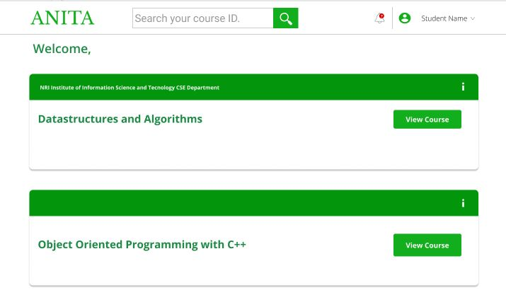
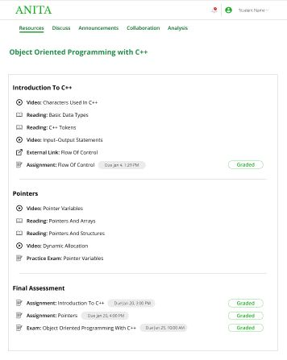
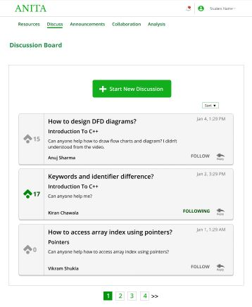
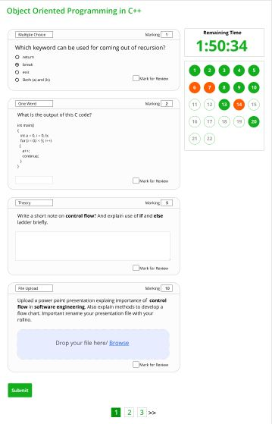
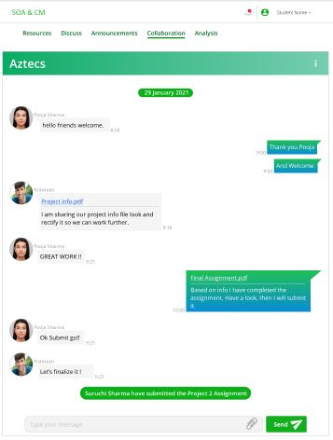
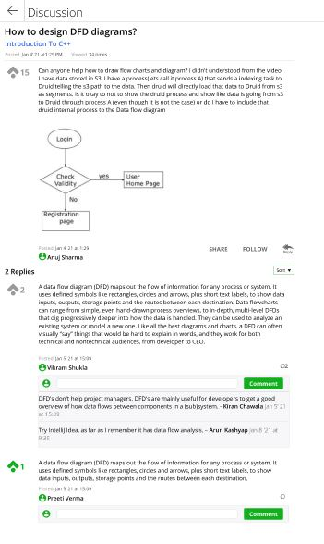
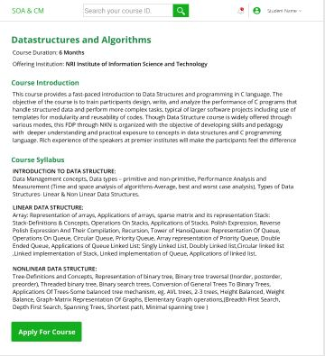
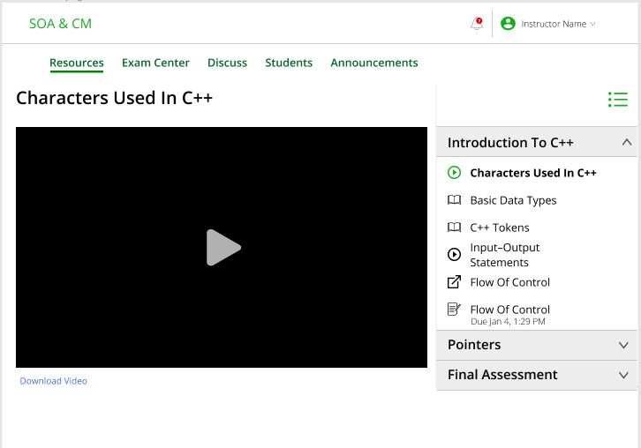
SCREENSHOTS

Slide 8
Business Plan
Market Opportunity
The global online learning industry is supporting massive annual growth of 19% or more per year, and it’s set to be a $243 billion industry within two years.
The major reason is, not a single product in the market is available which provides a gamut of WORK AUTOMATION, FEEDBACK,RECOMMENDATION, etc. with seamless connectivity, system scalability within affordable pricing range
According on a survey from UNESCO (2020). Millions of students reported tracking problems in current system.
Target Market
ANITA is intended for both the academic (K-12 and colleges/ universities) and corporate environments. Within the corporate environment, ANITA is targeted to all company sizes and industries.
Marketing Strategies
Using Social Media platforms to connect with our audience.
Including digital advertising in our marketing.
Solving appropriate problems which can help them.
Providing discounts to the initial users.
Offering the best services with minimum price.
Investing in better customer support, so we can have good word of mouth.
Business Model
Limited Time Licensing (Cloud Or Hosted)
According to the requirement user can choose to pay by per learner model or by the limited time licensing pricing model involves an annual fee that organizations pay to use the system.
Team Members
Software /Cloud developers
Solution /Cloud architects
Project managers
Quality engineer
Devops engineer
Marketing head
Social media advertising head

